Slide 1
CS2422 Assembly Language & System Programming
December 9, 2003

Slide 2
Today’s Topics
Basic Loader Functions
  Design of an Absolute Loader
  A Simple Bootstrap Loader
Machine-Dependent Loader Features
  Relocation
  Program Linking

Slide 3
Study Guide
Section 3.1
Section 3.2.1, 3.2.2

Slide 4
Introduction
To execute an object program, we needs
  Relocation, which modifies the object program so that it can be loaded at an address different from the location originally specified
  Linking, which combines two or more separate object programs and supplies the information needed to allow references between them
  Loading and Allocation, which allocates memory location and brings the object program into memory for execution

Slide 5
Overview of Chapter 3
Type of loaders
  Assemble-and-go loader
  Absolute loader (bootstrap loader)
  Relocating loader (relative loader)
  Direct linking loader
Design options
  Linkage editors
  Dynamic linking
  Bootstrap loaders

Slide 6
Assemble-and-go Loader
Characteristic
  The object code is stored in memory after assembly
  Single JUMP instruction
Advantage
  Simple, developing environment
Disadvantage
  Whenever the assembly program is to be executed, it has to be assembled again
  Programs have to be coded in the same language

Slide 7
Design of an Absolute Loader
Absolute Program
  Advantage
    Simple and efficient
  Disadvantage
    The need for programmer to specify the actual address
    Difficult to use subroutine libraries
Program Logic

Slide 8
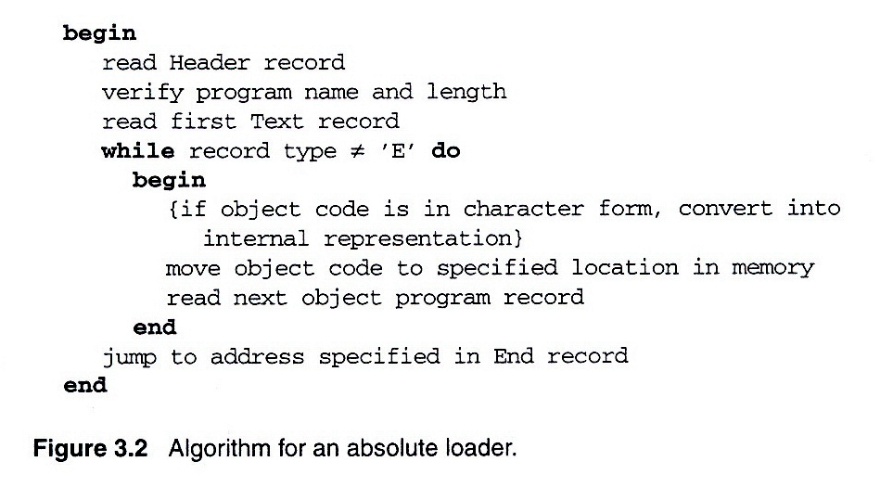
Fig. 3.2 Algorithm for an absolute loader

Slide 9
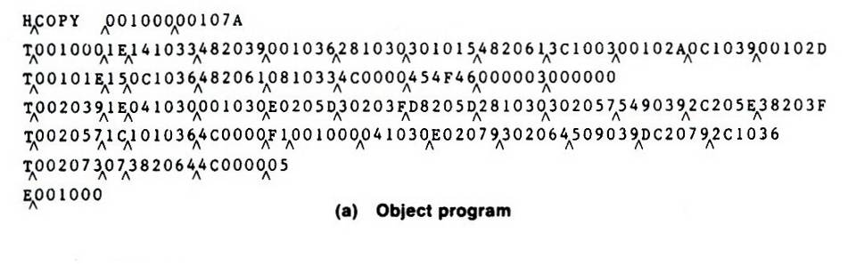
Loading of an absolute program (1/2)
Fig. 3.1(a)

Slide 10
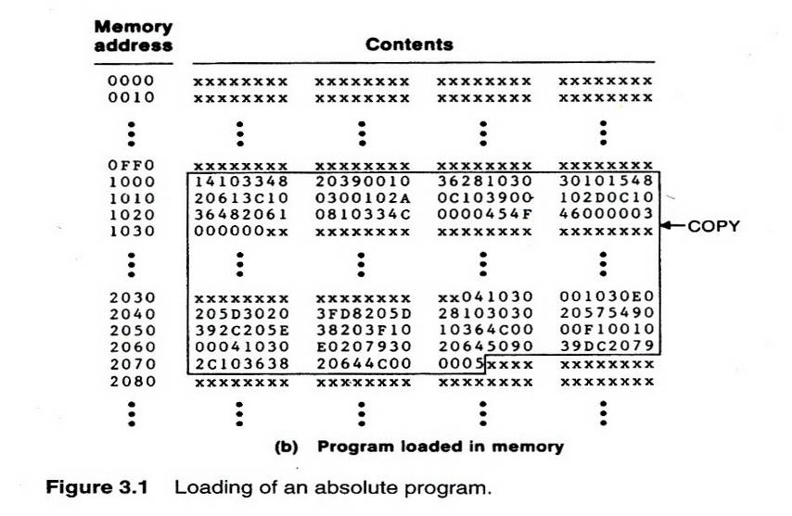
Loading of an absolute program (2/2)
Fig. 3.1(b)

Slide 11
Object Code Representation
Fig. 3.1(a)
  Each byte of assembled code is given using its hexadecimal representation in character form
  Easy to read by human beings
In general
  Each byte of object code is stored as a single byte
  Most machine store object programs in a binary form
  We must be sure that our file and device conventions do not cause some of the program bytes to be interpreted as control characters

Slide 12
A Simple Bootstrap Loader
Bootstrap Loader
  When a computer is first tuned on or restarted, a special type of absolute loader, called bootstrap loader is executed
  This bootstrap loads the first program to be run by the computer -- usually an operating system
Example (SIC bootstrap loader)
  The bootstrap itself begins at address 0
  It loads the OS starting address 0x80
  No header record or control information, the object code is consecutive bytes of memory

Slide 13
Bootstrap loader for SIC/XE
Begin
X=0x80 (the address of the next memory location to be loaded)
Loop
A←GETC (and convert it from the ASCII character code to the value of the hexadecimal digit)
save the value in the high-order 4 bits of S
A←GETC
combine the value to form one byte A← (A+S)
store the value (in A) to the address in register X
X←X+1
End
GETC A←read one character
if A=0x04 then jump to 0x80
if A<48 then GETC
A ← A-48 (0x30)
if A<10 then return
A ← A-7
return

Slide 14
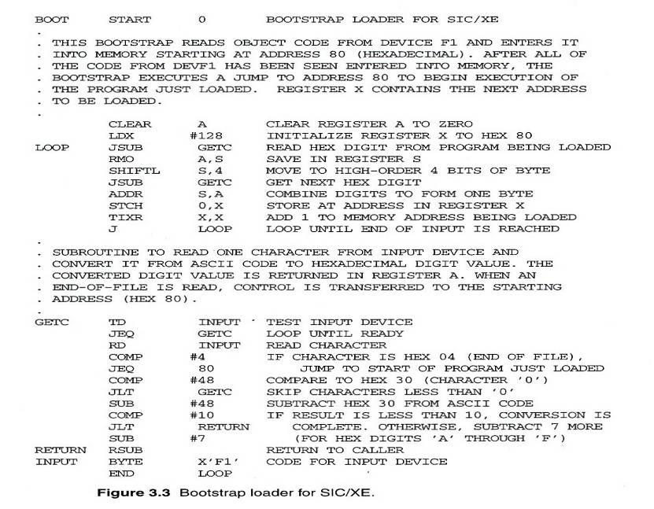
Fig. 3.3 Bootstrap loader for SIC/XE

Slide 15
Relocating Loaders
Motivation
  Efficient sharing of the machine with larger memory and when several independent programs are to be run together
  Support the use of subroutine libraries efficiently
Two methods for specifying relocation
  Modification record (Fig. 3.4, 3.5)
  Relocation bit (Fig. 3.6, 3.7)
    Each instruction is associated with one relocation bit
    These relocation bits in a Text record is gathered into bit masks

Slide 16
Modification Record
For complex machines
Also called RLD specification
  Relocation and Linkage Directory
Modification record
  col 1: M
  col 2-7: relocation address
  col 8-9: length (halfbyte)
  col 10: flag (+/-)
  col 11-17: segment name

Slide 17
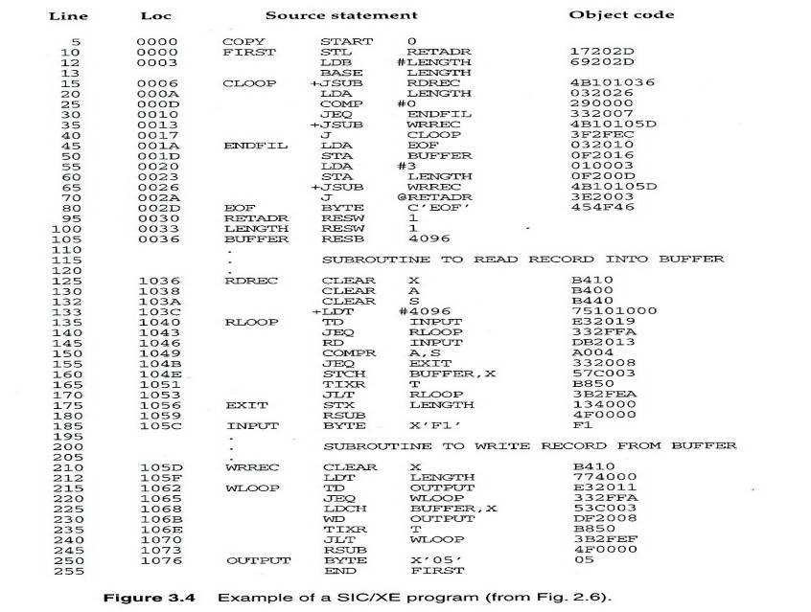
Fig. 3.4

Slide 18
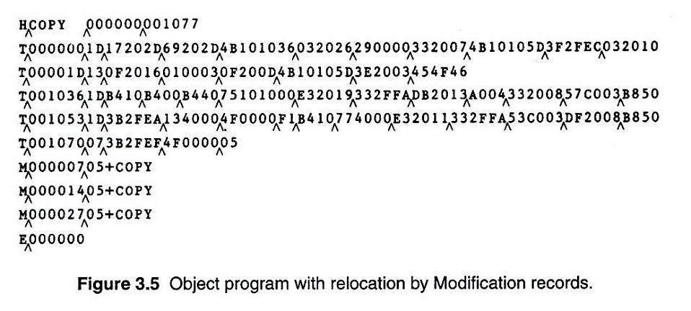
Fig. 3.5

Slide 19
Relocation Bit
For simple machines
Relocation bit
  0: No modification is necessary
  1: Modification is needed
Twelve-bit mask is used in each Text record
  Since each text record contains less than 12 words
  Unused words are set to 0
  Any value that is to be modified during relocation must coincide with one of these 3-byte segments
    e.g. line 210
Text record
  col 1: T
  col 2-7: starting address
  col 8-9: length (byte)
  col 10-12: relocation bits
  col 13-72: object code

Slide 20
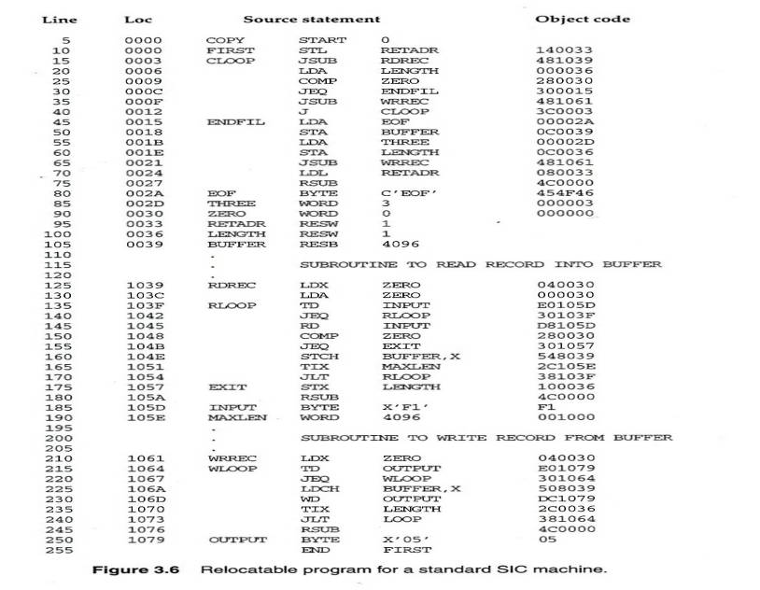
Fig. 3.6

Slide 21
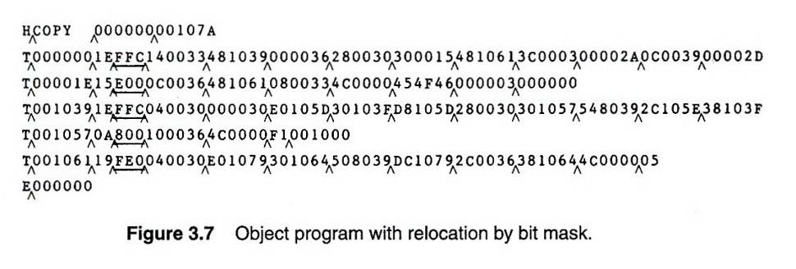
Fig. 3.7

Slide 22
Program Linking
Goal
  Resolve the problems with EXTREF and EXTDEF from different control sections (sec 2.3.5)
Example
  Program in Fig. 3.8 and object code in Fig. 3.9
  Use modification records for both relocation and linking
    Address constant
    External reference

Slide 23
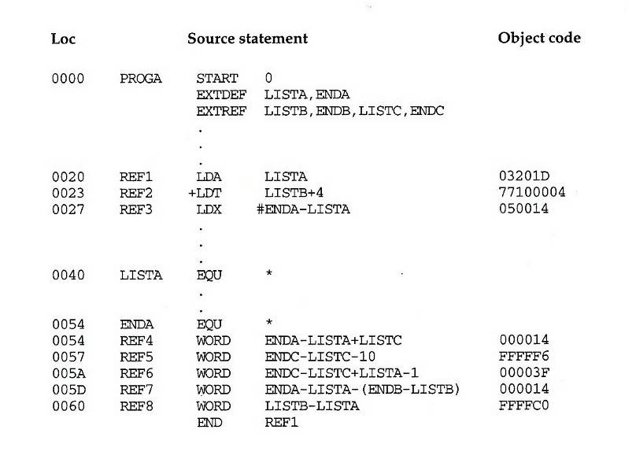
Fig. 3.8-1

Slide 24
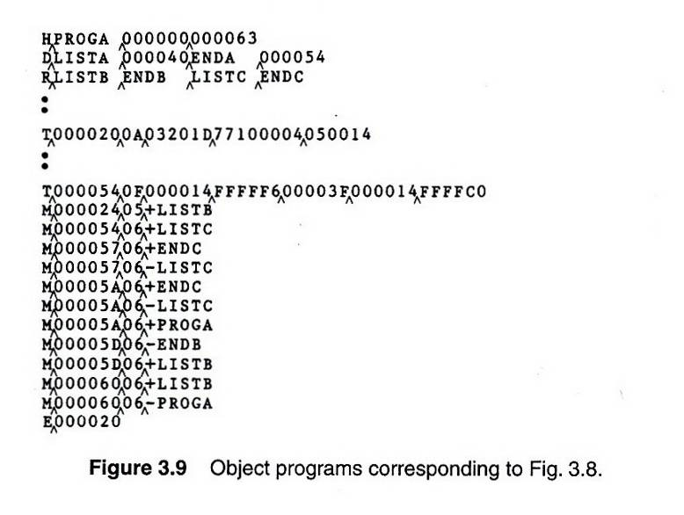
Fig. 3.9-1

Slide 25
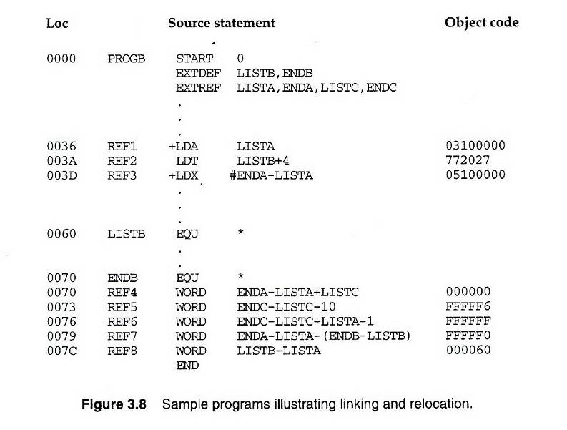
Fig. 3.8-2

Slide 26
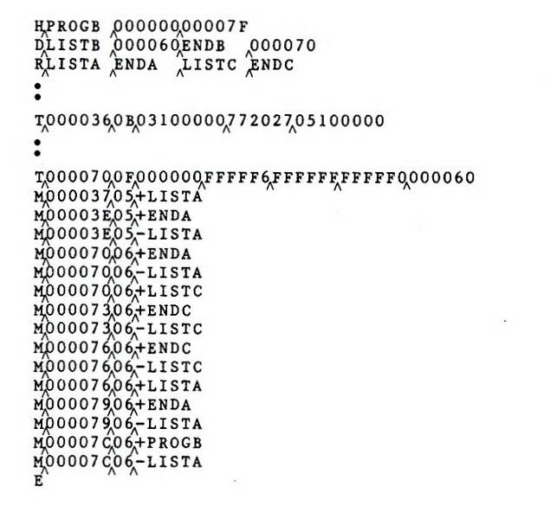
Fig. 3.9-2

Slide 27
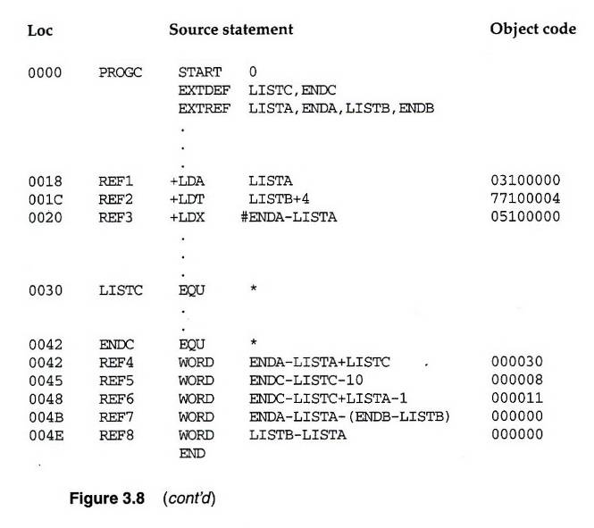
Fig. 3.8-3

Slide 28
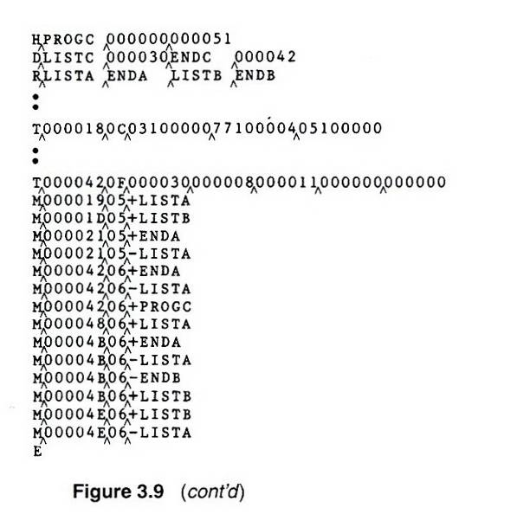
Fig. 3.9-3

Slide 29
Program Linking Example
Fig. 3.10
Load address for control sections
  PROGA 004000 63
  PROGB 004063 7F
  PROGC 0040E2 51
Load address for symbols
  LISTA: PROGA+0040=4040
  LISTB: PROGB+0060=40C3
  LISTC: PROGC+0030=4112
REF4 in PROGA
  ENDA-LISTA+LISTC=14+4112=4126
  T0000540F000014FFFFF600003F000014FFFFC0
  M00005406+LISTC

Slide 30
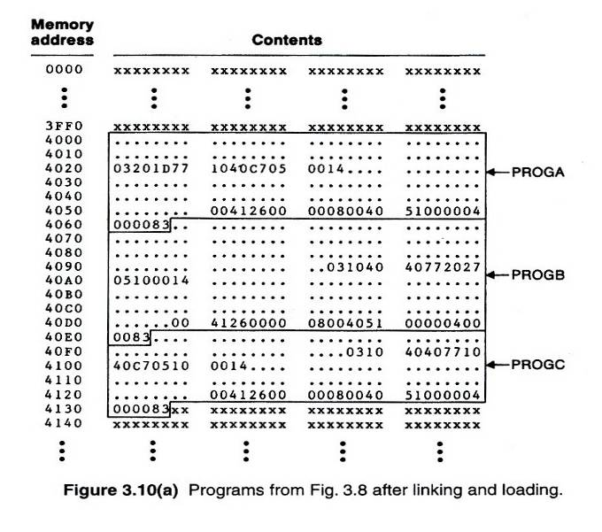
Fig. 3.10(a)

Slide 31
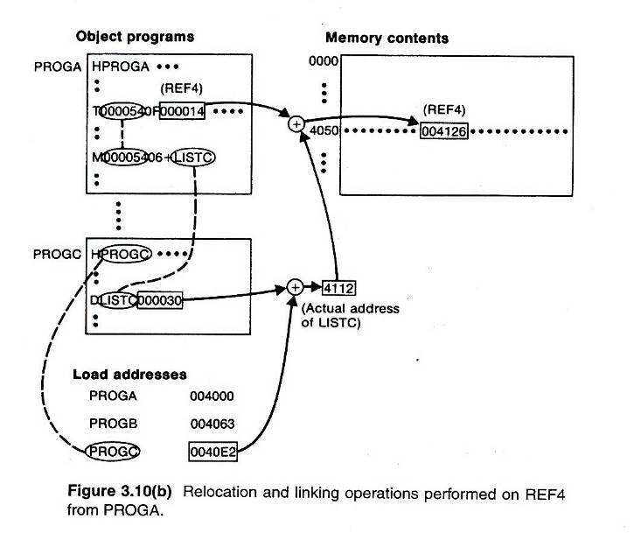
Fig. 3.10(b)

